Slide 1


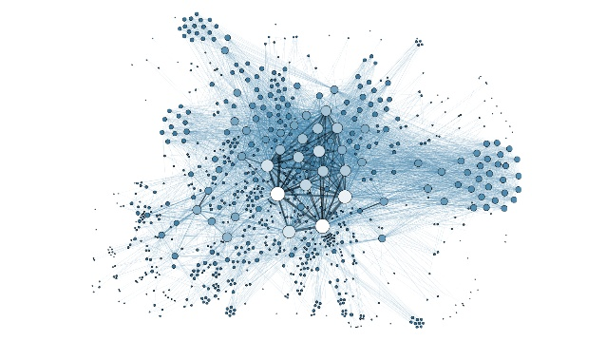

8th Semester Final Year Project Presentation 2021
Custom Accelerator for Graph Analytics
GROUP 26 (Batch 9)
Avani S (1PE17EC027)
Annette Antony (1PE17EC018)
Bhimala Subbarayudu (1PE17EC031)
Jeevan R (1PE17EC055)
Under the guidance of
Dr. Madhura Purnaprajna,
Professor, ECE Dept., PESU-ECC
PESIT BSC

Slide 2
OVERVIEW
Introduction
What is a Graph?
Problem Statement and Solution
Graph Representations
Sparse Matrix Representations
Single Source Shortest Path
PageRank
Breadth-First Search
Depth-First Search
Software – Vivado HLS and Vivado Design Suite
Hardware – PYNQ-Z2 Board
Results
Work Division
References
Algorithm
Partitioning Methodology
PESIT BSC

Slide 3
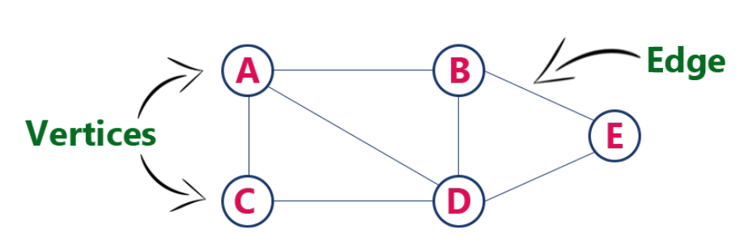
What is a Graph?
Graph is a data structure consisting of a set of vertices (V) and edges (E).
Vertices model objects.
Edges model relationships between objects.
Mathematically, graph G is represented as an ordered pair of its vertices and edges : G = (V, E)
In the figure shown above,
V = {A, B, C, D, E}
E = {(A,B), (A,C), (A,D), (B,D), (B,E), (C,D), (E,D)}
PESIT BSC

Slide 4
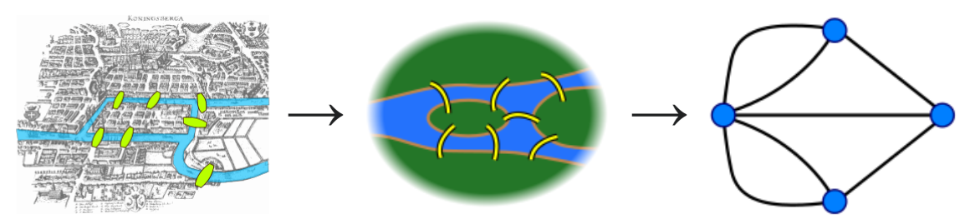
Introduction
Study of graph theory provides answers to many arrangement, networking, matching and operational problems.
Challenges involved in efficient graph processing:
Data-driven computations: partitioning computations is a difficult due to lack of knowledge about the structure of the computations.
Unstructured problems: irregular structure of the graph data makes it difficult to partition.
Poor locality: memory operations on graph datasets often exhibit poor temporal and spatial memory access locality characteristics.
High data access to computation ratio: leads to execution times dominated by memory latency.
Along with the above four major challenges, the ever-increasing sizes of the graph datasets gives the need for specialized hardware for efficient processing.
FPGAs could be explored as an energy-efficient solution to provide a specialized hardware for graph processing and offers exploration of massive parallelism.

Slide 5
Problem Statement and Solution
Problem Statement:
To design a custom FPGA accelerator for four graph algorithms, namely,
Single Source Shortest Path
PageRank
Breadth-First Search
Depth-First Search.
Solution:
Implement the respective graph algorithms in Vivado HLS.
Synthesize to generate RTL files.
Analyse the results by examining the latency, II, throughput, and resource utilization.
Optimise the algorithms with the relevant directives available in the Vivado HLS tool
Implement Graph Partitioning
Verify the results using C/RTL Cosim and export the IP.
Execute the graph on GAP Benchmark.
Compare the performance of the kernel.
PESIT BSC

Slide 6
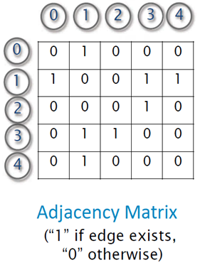
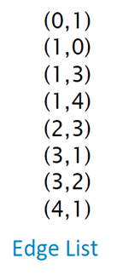
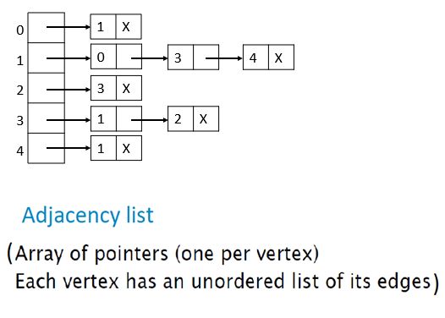
Graph Representations
0
1
2
4
3
PESIT BSC

Slide 7
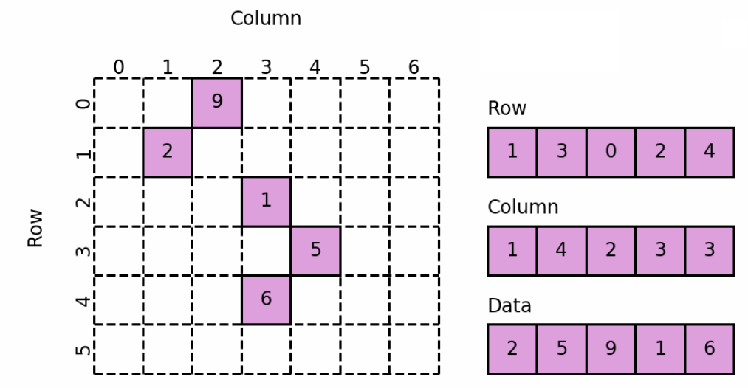
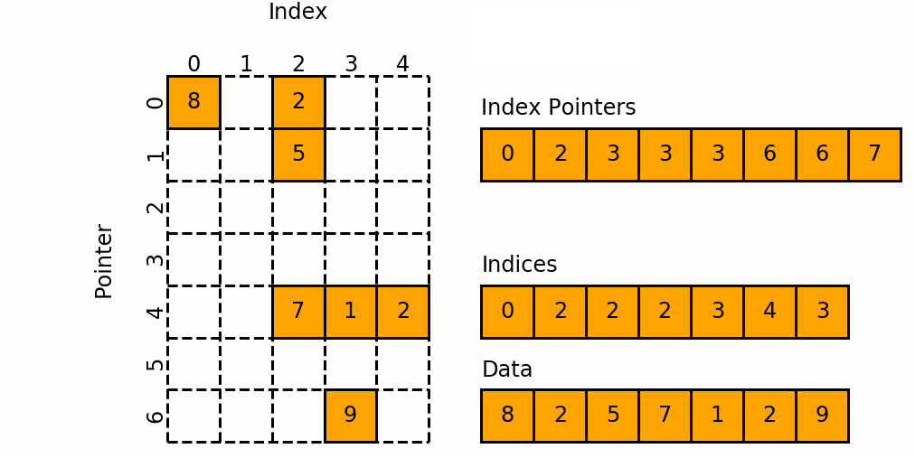
Sparse Matrix Representations
COO Format
Real world graph data sets have 96%-99% sparsity
Sparse matrix representations comprises only of non-zero values
Data, Row and Col are the three 1D arrays used in this representation.
Source: Google Images
CSR Format
Data: consists of the non-zero values
Row: consists of row indices of the elements in Data
Col: consists of column indices of the elements in Data
Index Pointers: represents the number of elements in each row.
Source: Google Images
PESIT BSC

Slide 8
Graph Algorithms
Single Source Shortest Path:
SSSP is an algorithm which computes the shortest path distances from a source node to all the other nodes in the entire graph.
Applications: Routing protocols for packet-routing on the Internet, Telephone networks, Google Maps.
PageRank:
PageRank is a link analysis algorithm that is used to measure the importance of the nodes in a particular network.
Applications: Ranking web pages, predicting traffic
Breadth-First Search:
BFS is a graph traversal algorithm which starts to traverse from a selected node, graph layer wise, thus exploring the neighbour nodes.
Applications: Broadcasting packets in Networks, Finding all neighbours in Peer-to-Peer Networks.
Depth-First-Search:
DFS is also a graph traversal algorithm, which starts at the root node and explores as far as possible along each branch before backtracking.
Applications: Strongly connected components and Weakly connected components, Detecting cycles in a graph
PESIT BSC

Slide 9
Single Source Shortest Path
4
5
6
0
1
2
3
7
8
9
0 | 1 | 2 | 3 | 4 | 5 | 6 | 7 | 8 | 9 | 10 | 11 | 12 | 13 | 14 | 15 | 16 | 17 | 18 | 19 | 20 | 21
1 | 0 | 2 | 4 | 5 | 7 | 8 | 1 | 3 | 5 | 6 | 8 | 9 | 2 | 1 | 1 | 2 | 2 | 1 | 1 | 2 | 2
0 | 1 | 7 | 13 | 14 | 15 | 17 | 18 | 19 | 21 | 22
0 | 1 | 2 | 3 | 4 | 5 | 6 | 7 | 8 | 9
q
vis
dist
0 | 0 | 0 | 0 | 0 | 0 | 0 | 0 | 0 | 0
inf | inf | inf | inf | inf | inf | inf | inf | inf | inf
PESIT BSC

Slide 10
Single Source Shortest Path
Single Source Shortest Path
4
5
6
REPEAT ‘V’ TIMES:
u = 0
for all neighbors ‘v’ of ‘u’ do
if(!vis[v] && dist[v] > dist[u] + edge_weight) do
dist[v] = dist[u] + edge_weight
vis[v] = 1
add ‘v’ to q
vis[u] = 1
0
1
2
3
7
8
9
0 | 1 | 2 | 3 | 4 | 5 | 6 | 7 | 8 | 9 | 10 | 11 | 12 | 13 | 14 | 15 | 16 | 17 | 18 | 19 | 20 | 21
1 | 0 | 2 | 4 | 5 | 7 | 8 | 1 | 3 | 5 | 6 | 8 | 9 | 2 | 1 | 1 | 2 | 2 | 1 | 1 | 2 | 2
0 | 1 | 7 | 13 | 14 | 15 | 17 | 18 | 19 | 21 | 22
0 | 1 | 2 | 3 | 4 | 5 | 6 | 7 | 8 | 9
q
vis
dist
0
0 | 0 | 0 | 0 | 0 | 0 | 0 | 0 | 0 | 0
0 | inf | inf | inf | inf | inf | inf | inf | inf | inf
PESIT BSC

Slide 11
Single Source Shortest Path
Single Source Shortest Path
4
5
6
REPEAT ‘V’ TIMES:
u = 0
for all neighbors ‘v’ of ‘u’ do
if(!vis[v] && dist[v] > dist[u] + edge_weight) do
dist[v] = dist[u] + edge_weight
vis[v] = 1
add ‘v’ to q
vis[u] = 1
0
1
2
3
7
8
9
0 | 1 | 2 | 3 | 4 | 5 | 6 | 7 | 8 | 9 | 10 | 11 | 12 | 13 | 14 | 15 | 16 | 17 | 18 | 19 | 20 | 21
1 | 0 | 2 | 4 | 5 | 7 | 8 | 1 | 3 | 5 | 6 | 8 | 9 | 2 | 1 | 1 | 2 | 2 | 1 | 1 | 2 | 2
0 | 1 | 7 | 13 | 14 | 15 | 17 | 18 | 19 | 21 | 22
0 | 1 | 2 | 3 | 4 | 5 | 6 | 7 | 8 | 9
q
vis
dist
0 | 1
1 | 1 | 0 | 0 | 0 | 0 | 0 | 0 | 0 | 0
0 | 1 | inf | inf | inf | inf | inf | inf | inf | inf
PESIT BSC

Slide 12
Single Source Shortest Path
Single Source Shortest Path
4
5
6
REPEAT ‘V’ TIMES:
u = 1
for all neighbors ‘v’ of ‘u’ do
if(!vis[v] && dist[v] > dist[u] + edge_weight) do
dist[v] = dist[u] + edge_weight
vis[v] = 1
add ‘v’ to q
vis[u] = 1
0
1
2
3
7
8
9
0 | 1 | 2 | 3 | 4 | 5 | 6 | 7 | 8 | 9 | 10 | 11 | 12 | 13 | 14 | 15 | 16 | 17 | 18 | 19 | 20 | 21
1 | 0 | 2 | 4 | 5 | 7 | 8 | 1 | 3 | 5 | 6 | 8 | 9 | 2 | 1 | 1 | 2 | 2 | 1 | 1 | 2 | 2
0 | 1 | 7 | 13 | 14 | 15 | 17 | 18 | 19 | 21 | 22
0 | 1 | 2 | 3 | 4 | 5 | 6 | 7 | 8 | 9
q
vis
dist
0 | 1
1 | 1 | 0 | 0 | 0 | 0 | 0 | 0 | 0 | 0
0 | 1 | inf | inf | inf | inf | inf | inf | inf | inf
PESIT BSC

Slide 13
Single Source Shortest Path
Single Source Shortest Path
4
5
6
REPEAT ‘V’ TIMES:
u = 1
for all neighbors ‘v’ of ‘u’ do
if(!vis[v] && dist[v] > dist[u] + edge_weight) do
dist[v] = dist[u] + edge_weight
vis[v] = 1
add ‘v’ to q
vis[u] = 1
0
1
2
3
7
8
9
0 | 1 | 2 | 3 | 4 | 5 | 6 | 7 | 8 | 9 | 10 | 11 | 12 | 13 | 14 | 15 | 16 | 17 | 18 | 19 | 20 | 21
1 | 0 | 2 | 4 | 5 | 7 | 8 | 1 | 3 | 5 | 6 | 8 | 9 | 2 | 1 | 1 | 2 | 2 | 1 | 1 | 2 | 2
0 | 1 | 7 | 13 | 14 | 15 | 17 | 18 | 19 | 21 | 22
0 | 1 | 2 | 3 | 4 | 5 | 6 | 7 | 8 | 9
q
vis
dist
0 | 1 | 2 | 4 | 5 | 7 | 8
1 | 1 | 1 | 0 | 1 | 1 | 0 | 1 | 1 | 0
0 | 1 | 2 | inf | 2 | 2 | inf | 2 | 2 | inf
PESIT BSC

Slide 14
Single Source Shortest Path
Single Source Shortest Path
4
5
6
REPEAT ‘V’ TIMES:
u = 2
for all neighbors ‘v’ of ‘u’ do
if(!vis[v] && dist[v] > dist[u] + edge_weight) do
dist[v] = dist[u] + edge_weight
vis[v] = 1
add ‘v’ to q
vis[u] = 1
0
1
2
3
7
8
9
0 | 1 | 2 | 3 | 4 | 5 | 6 | 7 | 8 | 9 | 10 | 11 | 12 | 13 | 14 | 15 | 16 | 17 | 18 | 19 | 20 | 21
1 | 0 | 2 | 4 | 5 | 7 | 8 | 1 | 3 | 5 | 6 | 8 | 9 | 2 | 1 | 1 | 2 | 2 | 1 | 1 | 2 | 2
0 | 1 | 7 | 13 | 14 | 15 | 17 | 18 | 19 | 21 | 22
0 | 1 | 2 | 3 | 4 | 5 | 6 | 7 | 8 | 9
q
vis
dist
0 | 1 | 2 | 4 | 5 | 7 | 8
1 | 1 | 1 | 0 | 1 | 1 | 0 | 1 | 1 | 0
0 | 1 | 2 | inf | 2 | 2 | inf | 2 | 2 | inf
PESIT BSC

Slide 15
Single Source Shortest Path
Single Source Shortest Path
4
5
6
REPEAT ‘V’ TIMES:
u = 2
for all neighbors ‘v’ of ‘u’ do
if(!vis[v] && dist[v] > dist[u] + edge_weight) do
dist[v] = dist[u] + edge_weight
vis[v] = 1
add ‘v’ to q
vis[u] = 1
0
1
2
3
7
8
9
0 | 1 | 2 | 3 | 4 | 5 | 6 | 7 | 8 | 9 | 10 | 11 | 12 | 13 | 14 | 15 | 16 | 17 | 18 | 19 | 20 | 21
1 | 0 | 2 | 4 | 5 | 7 | 8 | 1 | 3 | 5 | 6 | 8 | 9 | 2 | 1 | 1 | 2 | 2 | 1 | 1 | 2 | 2
0 | 1 | 7 | 13 | 14 | 15 | 17 | 18 | 19 | 21 | 22
0 | 1 | 2 | 3 | 4 | 5 | 6 | 7 | 8 | 9
q
vis
dist
0 | 1 | 2 | 4 | 5 | 7 | 8 | 3 | 6 | 9
1 | 1 | 1 | 1 | 1 | 1 | 1 | 1 | 1 | 1
0 | 1 | 2 | 3 | 2 | 2 | 3 | 2 | 2 | 3
PESIT BSC

Slide 16
Single Source Shortest Path
Single Source Shortest Path
4
5
6
REPEAT ‘V’ TIMES:
u = 4
for all neighbors ‘v’ of ‘u’ do
if(!vis[v] && dist[v] > dist[u] + edge_weight) do
dist[v] = dist[u] + edge_weight
vis[v] = 1
add ‘v’ to q
vis[u] = 1
0
1
2
3
7
8
9
0 | 1 | 2 | 3 | 4 | 5 | 6 | 7 | 8 | 9 | 10 | 11 | 12 | 13 | 14 | 15 | 16 | 17 | 18 | 19 | 20 | 21
1 | 0 | 2 | 4 | 5 | 7 | 8 | 1 | 3 | 5 | 6 | 8 | 9 | 2 | 1 | 1 | 2 | 2 | 1 | 1 | 2 | 2
0 | 1 | 7 | 13 | 14 | 15 | 17 | 18 | 19 | 21 | 22
0 | 1 | 2 | 3 | 4 | 5 | 6 | 7 | 8 | 9
q
vis
dist
0 | 1 | 2 | 4 | 5 | 7 | 8 | 3 | 6 | 9
1 | 1 | 1 | 1 | 1 | 1 | 1 | 1 | 1 | 1
0 | 1 | 2 | 3 | 2 | 2 | 3 | 2 | 2 | 3
PESIT BSC

Slide 17
Single Source Shortest Path
Single Source Shortest Path
4
5
6
REPEAT ‘V’ TIMES:
u = 5
for all neighbors ‘v’ of ‘u’ do
if(!vis[v] && dist[v] > dist[u] + edge_weight) do
dist[v] = dist[u] + edge_weight
vis[v] = 1
add ‘v’ to q
vis[u] = 1
0
1
2
3
7
8
9
0 | 1 | 2 | 3 | 4 | 5 | 6 | 7 | 8 | 9 | 10 | 11 | 12 | 13 | 14 | 15 | 16 | 17 | 18 | 19 | 20 | 21
1 | 0 | 2 | 4 | 5 | 7 | 8 | 1 | 3 | 5 | 6 | 8 | 9 | 2 | 1 | 1 | 2 | 2 | 1 | 1 | 2 | 2
0 | 1 | 7 | 13 | 14 | 15 | 17 | 18 | 19 | 21 | 22
0 | 1 | 2 | 3 | 4 | 5 | 6 | 7 | 8 | 9
q
vis
dist
0 | 1 | 2 | 4 | 5 | 7 | 8 | 3 | 6 | 9
1 | 1 | 1 | 1 | 1 | 1 | 1 | 1 | 1 | 1
0 | 1 | 2 | 3 | 2 | 2 | 3 | 2 | 2 | 3
PESIT BSC

Slide 18
Single Source Shortest Path
Single Source Shortest Path
4
5
6
REPEAT ‘V’ TIMES:
u = 9
for all neighbors ‘v’ of ‘u’ do #pragma HLS PIPELINE
if(!vis[v] && dist[v] > dist[u] + edge_weight) do
dist[v] = dist[u] + edge_weight
vis[v] = 1
add ‘v’ to q
vis[u] = 1
0
1
2
3
7
8
9
0 | 1 | 2 | 3 | 4 | 5 | 6 | 7 | 8 | 9 | 10 | 11 | 12 | 13 | 14 | 15 | 16 | 17 | 18 | 19 | 20 | 21
1 | 0 | 2 | 4 | 5 | 7 | 8 | 1 | 3 | 5 | 6 | 8 | 9 | 2 | 1 | 1 | 2 | 2 | 1 | 1 | 2 | 2
0 | 1 | 7 | 13 | 14 | 15 | 17 | 18 | 19 | 21 | 22
0 | 1 | 2 | 3 | 4 | 5 | 6 | 7 | 8 | 9
q
vis
dist
0 | 1 | 2 | 4 | 5 | 7 | 8 | 3 | 6 | 9
1 | 1 | 1 | 1 | 1 | 1 | 1 | 1 | 1 | 1
0 | 1 | 2 | 3 | 2 | 2 | 3 | 2 | 2 | 3
FINAL DISTANCES
PESIT BSC

Slide 19
Single Source Shortest Path – PARTITIONING METHODOLOGY
4
5
6
GLOBAL
0 | 1 | 2 | 3 | 4 | 5 | 6 | 7 | 8 | 9
q
vis
dist
0
0 | 0 | 0 | 0 | 0 | 0 | 0 | 0 | 0 | 0
0 | inf | inf | inf | inf | inf | inf | inf | inf | inf
0
1
2
3
7
8
9
0 | 1 | 2 | 3 | 4 | 5 | 6 | 7 | 8 | 9 | 10 | 11 | 12 | 13 | 14 | 15 | 16 | 17 | 18 | 19 | 20 | 21
1 | 0 | 2 | 4 | 5 | 7 | 8 | 1 | 3 | 5 | 6 | 8 | 9 | 2 | 1 | 1 | 2 | 2 | 1 | 1 | 2 | 2
0 | 1 | 7 | 13 | 14 | 15 | 17 | 18 | 19 | 21 | 22
1 | 6 | 6 | 1 | 1 | 2 | 1 | 1 | 2 | 1
LOCAL
REPEAT ‘V’ TIMES:
u = 0
partition(u, dist[u], degree[u], queue, visited, distance, neighbors)
vis[u] = 1
queue
visited
distance
neighbors
0
inf
1
PESIT BSC

Slide 20
Single Source Shortest Path – PARTITIONING METHODOLOGY
4
5
6
GLOBAL
0 | 1 | 2 | 3 | 4 | 5 | 6 | 7 | 8 | 9
q
vis
dist
0
0 | 0 | 0 | 0 | 0 | 0 | 0 | 0 | 0 | 0
0 | inf | inf | inf | inf | inf | inf | inf | inf | inf
0
1
2
3
7
8
9
0 | 1 | 2 | 3 | 4 | 5 | 6 | 7 | 8 | 9 | 10 | 11 | 12 | 13 | 14 | 15 | 16 | 17 | 18 | 19 | 20 | 21
1 | 0 | 2 | 4 | 5 | 7 | 8 | 1 | 3 | 5 | 6 | 8 | 9 | 2 | 1 | 1 | 2 | 2 | 1 | 1 | 2 | 2
0 | 1 | 7 | 13 | 14 | 15 | 17 | 18 | 19 | 21 | 22
1 | 6 | 6 | 1 | 1 | 2 | 1 | 1 | 2 | 1
LOCAL
REPEAT ‘V’ TIMES:
u = 0
partition(u, dist[u], degree[u], queue, visited, distance, neighbors)
vis[u] = 1
queue
visited
distance
neighbors
1
0
1
1
PESIT BSC

Slide 21
Single Source Shortest Path – PARTITIONING METHODOLOGY
4
5
6
GLOBAL
0 | 1 | 2 | 3 | 4 | 5 | 6 | 7 | 8 | 9
q
vis
dist
0 | 1
1 | 1 | 0 | 0 | 0 | 0 | 0 | 0 | 0 | 0
0 | 1 | inf | inf | inf | inf | inf | inf | inf | inf
0
1
2
3
7
8
9
0 | 1 | 2 | 3 | 4 | 5 | 6 | 7 | 8 | 9 | 10 | 11 | 12 | 13 | 14 | 15 | 16 | 17 | 18 | 19 | 20 | 21
1 | 0 | 2 | 4 | 5 | 7 | 8 | 1 | 3 | 5 | 6 | 8 | 9 | 2 | 1 | 1 | 2 | 2 | 1 | 1 | 2 | 2
0 | 1 | 7 | 13 | 14 | 15 | 17 | 18 | 19 | 21 | 22
1 | 6 | 6 | 1 | 1 | 2 | 1 | 1 | 2 | 1
LOCAL
REPEAT ‘V’ TIMES:
u = 0
partition(u, dist[u], degree[u], queue, visited, distance, neighbors)
vis[u] = 1
queue
visited
distance
neighbors
1
1
1
1
PESIT BSC

Slide 22
Single Source Shortest Path – PARTITIONING METHODOLOGY
4
5
6
GLOBAL
0 | 1 | 2 | 3 | 4 | 5 | 6 | 7 | 8 | 9
q
vis
dist
0 | 1
1 | 1 | 0 | 0 | 0 | 0 | 0 | 0 | 0 | 0
0 | 1 | inf | inf | inf | inf | inf | inf | inf | inf
0
1
2
3
7
8
9
0 | 1 | 2 | 3 | 4 | 5 | 6 | 7 | 8 | 9 | 10 | 11 | 12 | 13 | 14 | 15 | 16 | 17 | 18 | 19 | 20 | 21
1 | 0 | 2 | 4 | 5 | 7 | 8 | 1 | 3 | 5 | 6 | 8 | 9 | 2 | 1 | 1 | 2 | 2 | 1 | 1 | 2 | 2
0 | 1 | 7 | 13 | 14 | 15 | 17 | 18 | 19 | 21 | 22
1 | 6 | 6 | 1 | 1 | 2 | 1 | 1 | 2 | 1
LOCAL
REPEAT ‘V’ TIMES:
u = 1
partition(u, dist[u], degree[u], queue, visited, distance, neighbors)
vis[u] = 1
queue
visited
distance
neighbors
1 | 0 | 0 | 0 | 0 | 0
0 | inf | inf | inf | inf | inf
0 | 2 | 4 | 5 | 7 | 8
PESIT BSC

Slide 23
Single Source Shortest Path – PARTITIONING METHODOLOGY
4
5
6
GLOBAL
0 | 1 | 2 | 3 | 4 | 5 | 6 | 7 | 8 | 9
q
vis
dist
0 | 1
1 | 1 | 0 | 0 | 0 | 0 | 0 | 0 | 0 | 0
0 | 1 | inf | inf | inf | inf | inf | inf | inf | inf
0
1
2
3
7
8
9
0 | 1 | 2 | 3 | 4 | 5 | 6 | 7 | 8 | 9 | 10 | 11 | 12 | 13 | 14 | 15 | 16 | 17 | 18 | 19 | 20 | 21
1 | 0 | 2 | 4 | 5 | 7 | 8 | 1 | 3 | 5 | 6 | 8 | 9 | 2 | 1 | 1 | 2 | 2 | 1 | 1 | 2 | 2
0 | 1 | 7 | 13 | 14 | 15 | 17 | 18 | 19 | 21 | 22
1 | 6 | 6 | 1 | 1 | 2 | 1 | 1 | 2 | 1
LOCAL
REPEAT ‘V’ TIMES:
u = 1
partition(u, dist[u], degree[u], queue, visited, distance, neighbors)
vis[u] = 1
queue
visited
distance
neighbors
2 | 4 | 5 | 7 | 8
1 | 1 | 1 | 1 | 1 | 1
0 | 2 | 2 | 2 | 2 | 2
0 | 2 | 4 | 5 | 7 | 8
PESIT BSC

Slide 24
Single Source Shortest Path – PARTITIONING METHODOLOGY
4
5
6
GLOBAL
0 | 1 | 2 | 3 | 4 | 5 | 6 | 7 | 8 | 9
q
vis
dist
0 | 1 | 2 | 4 | 5 | 7 | 8
1 | 1 | 1 | 0 | 1 | 1 | 0 | 1 | 1 | 0
0 | 1 | 2 | inf | 2 | 2 | inf | 2 | 2 | inf
0
1
2
3
7
8
9
0 | 1 | 2 | 3 | 4 | 5 | 6 | 7 | 8 | 9 | 10 | 11 | 12 | 13 | 14 | 15 | 16 | 17 | 18 | 19 | 20 | 21
1 | 0 | 2 | 4 | 5 | 7 | 8 | 1 | 3 | 5 | 6 | 8 | 9 | 2 | 1 | 1 | 2 | 2 | 1 | 1 | 2 | 2
0 | 1 | 7 | 13 | 14 | 15 | 17 | 18 | 19 | 21 | 22
1 | 6 | 6 | 1 | 1 | 2 | 1 | 1 | 2 | 1
LOCAL
REPEAT ‘V’ TIMES:
u = 1
partition(u, dist[u], degree[u], queue, visited, distance, neighbors)
vis[u] = 1
queue
visited
distance
neighbors
2 | 4 | 5 | 7 | 8
1 | 1 | 1 | 1 | 1 | 1
0 | 2 | 2 | 2 | 2 | 2
0 | 2 | 4 | 5 | 7 | 8
PESIT BSC

Slide 25
Single Source Shortest Path – PARTITIONING METHODOLOGY
4
5
6
GLOBAL
0 | 1 | 2 | 3 | 4 | 5 | 6 | 7 | 8 | 9
q
vis
dist
0 | 1 | 2 | 4 | 5 | 7 | 8
1 | 1 | 1 | 0 | 1 | 1 | 0 | 1 | 1 | 0
0 | 1 | 2 | inf | 2 | 2 | inf | 2 | 2 | inf
0
1
2
3
7
8
9
0 | 1 | 2 | 3 | 4 | 5 | 6 | 7 | 8 | 9 | 10 | 11 | 12 | 13 | 14 | 15 | 16 | 17 | 18 | 19 | 20 | 21
1 | 0 | 2 | 4 | 5 | 7 | 8 | 1 | 3 | 5 | 6 | 8 | 9 | 2 | 1 | 1 | 2 | 2 | 1 | 1 | 2 | 2
0 | 1 | 7 | 13 | 14 | 15 | 17 | 18 | 19 | 21 | 22
 |  |  | 1 | 1 | 2 | 1 | 1 | 2 | 1
LOCAL
REPEAT ‘V’ TIMES:
u = 2
partition(u, dist[u], degree[u], queue, visited, distance, neighbors)
vis[u] = 1
queue
visited
distance
neighbors
1 | 0 | 1 | 0 | 1 | 0
1 | inf | 1 | inf | 2 | inf
1 | 3 | 5 | 6 | 8 | 9
PESIT BSC

Slide 26
Single Source Shortest Path – PARTITIONING METHODOLOGY
4
5
6
GLOBAL
0 | 1 | 2 | 3 | 4 | 5 | 6 | 7 | 8 | 9
q
vis
dist
0 | 1 | 2 | 4 | 5 | 7 | 8
1 | 1 | 1 | 0 | 1 | 1 | 0 | 1 | 1 | 0
0 | 1 | 2 | inf | 2 | 2 | inf | 2 | 2 | inf
0
1
2
3
7
8
9
0 | 1 | 2 | 3 | 4 | 5 | 6 | 7 | 8 | 9 | 10 | 11 | 12 | 13 | 14 | 15 | 16 | 17 | 18 | 19 | 20 | 21
1 | 0 | 2 | 4 | 5 | 7 | 8 | 1 | 3 | 5 | 6 | 8 | 9 | 2 | 1 | 1 | 2 | 2 | 1 | 1 | 2 | 2
0 | 1 | 7 | 13 | 14 | 15 | 17 | 18 | 19 | 21 | 22
1 | 6 | 6 | 1 | 1 | 2 | 1 | 1 | 2 | 1
LOCAL
REPEAT ‘V’ TIMES:
u = 2
partition(u, dist[u], degree[u], queue, visited, distance, neighbors)
vis[u] = 1
queue
visited
distance
neighbors
3 | 6 | 9
1 | 1 | 1 | 1 | 1 | 1
1 | 3 | 1 | 3 | 2 | 3
1 | 3 | 5 | 6 | 8 | 9
PESIT BSC

Slide 27
Single Source Shortest Path – PARTITIONING METHODOLOGY
4
5
6
GLOBAL
0 | 1 | 2 | 3 | 4 | 5 | 6 | 7 | 8 | 9
q
vis
dist
0 | 1 | 2 | 4 | 5 | 7 | 8 | 3 | 6 | 9
1 | 1 | 1 | 1 | 1 | 1 | 1 | 1 | 1 | 1
0 | 1 | 2 | 3 | 2 | 2 | 3 | 2 | 2 | 3
0
1
2
3
7
8
9
0 | 1 | 2 | 3 | 4 | 5 | 6 | 7 | 8 | 9 | 10 | 11 | 12 | 13 | 14 | 15 | 16 | 17 | 18 | 19 | 20 | 21
1 | 0 | 2 | 4 | 5 | 7 | 8 | 1 | 3 | 5 | 6 | 8 | 9 | 2 | 1 | 1 | 2 | 2 | 1 | 1 | 2 | 2
0 | 1 | 7 | 13 | 14 | 15 | 17 | 18 | 19 | 21 | 22
1 | 6 | 6 | 1 | 1 | 2 | 1 | 1 | 2 | 1
LOCAL
REPEAT ‘V’ TIMES:
u = 2
partition(u, dist[u], degree[u], queue, visited, distance, neighbors)
vis[u] = 1
queue
visited
distance
neighbors
3 | 6 | 9
1 | 1 | 1 | 1 | 1 | 1
1 | 3 | 1 | 3 | 2 | 3
1 | 3 | 5 | 6 | 8 | 9
PESIT BSC

Slide 28
Single Source Shortest Path – PARTITIONING METHODOLOGY
4
5
6
GLOBAL
0 | 1 | 2 | 3 | 4 | 5 | 6 | 7 | 8 | 9
q
vis
dist
0 | 1 | 2 | 4 | 5 | 7 | 8 | 3 | 6 | 9
1 | 1 | 1 | 1 | 1 | 1 | 1 | 1 | 1 | 1
0 | 1 | 2 | 3 | 2 | 2 | 3 | 2 | 2 | 3
0
1
2
3
7
8
9
0 | 1 | 2 | 3 | 4 | 5 | 6 | 7 | 8 | 9 | 10 | 11 | 12 | 13 | 14 | 15 | 16 | 17 | 18 | 19 | 20 | 21
1 | 0 | 2 | 4 | 5 | 7 | 8 | 1 | 3 | 5 | 6 | 8 | 9 | 2 | 1 | 1 | 2 | 2 | 1 | 1 | 2 | 2
0 | 1 | 7 | 13 | 14 | 15 | 17 | 18 | 19 | 21 | 22
1 | 6 | 6 | 1 | 1 | 2 | 1 | 1 | 2 | 1
LOCAL
REPEAT ‘V’ TIMES:
u = 9
partition(u, dist[u], degree[u], queue, visited, distance, neighbors)
vis[u] = 1
queue
visited
distance
neighbors
1
2
2
PESIT BSC

Slide 29
PageRank
PageRank is a link analysis algorithm which assigns a numerical weighting to each element of a hyperlinked set of nodes with the purpose of measuring its relative importance within the set.
More links to a page Page is more important
B
Adjacency Matrix: Outlink vector:
0 1 1 0
0 0 0 1
1 0 1
0 0 1 0
2
1
3
1
D
A
C
Normalized Matrix: Transpose
0 0.5 0.5 0
0 0 0 1
0.33 0.33 0 0.33
0 0 1 0
0 0 0.33 0
0.5 0 0.33 0
0.5 0 0 1
0 1 0.33 0
GRAPH CONSIDERED:
4 NODES
7 EDGES
PESIT BSC

Slide 30
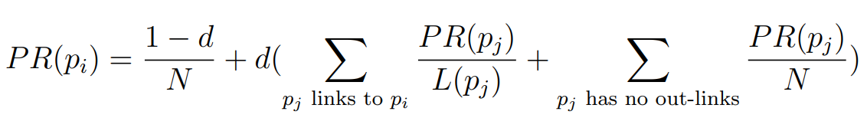
PageRank
COO Format:
VALUE: 0.33 0.5 0.33 0.5 1 1 0.33
ROW: 0 1 1 2 2 3 3
COL : 2 0 2 0 4 1 2
Initial PAGERANK Vector:
0.25
0.25
0.25
0.25
PageRank Formula:
PESIT BSC

Slide 31
PageRank
MATRIX MULTIPLICATION: (ADJACENCY MATRIX)
p_new[0] = p_new[0] + a[0][0]*p[0]​
= p_new[0] + a[0][1]*p[1]​
= p_new[0] + a[0][2]*p[2]​
= p_new[0] + a[0][3]*p[3]​
​
p_new[1] = p_new[1] + a[1][0]*p[0]​
= p_new[1] + a[1][1]*p[1]​
= p_new[1] + a[1][2]*p[2]​
= p_new[1] + a[1][3]*p[3]​
p_new[2] = p_new[2] + a[2][0]*p[0]​
= p_new[2] + a[2][1]*p[1]​
= p_new[2] + a[2][2]*p[2]​
= p_new[2] + a[2][3]*p[3]​
​
p_new[3] = p_new[3] + a[3][0]*p[0]​
= p_new[3] + a[3][1]*p[1]​
= p_new[3] + a[3][2]*p[2]​
= p_new[3] + a[3][3]*p[3]​
PESIT BSC

Slide 32
PageRank
MATRIX MULTIPLICATION: (ADJACENCY MATRIX)
p_new[0] = p_new[0] + a[0][0]*p[0]​
= p_new[0] + a[0][1]*p[1]​
= p_new[0] + a[0][2]*p[2]​
= p_new[0] + a[0][3]*p[3]​
​
p_new[1] = p_new[1] + a[1][0]*p[0]​
= p_new[1] + a[1][1]*p[1]​
= p_new[1] + a[1][2]*p[2]​
= p_new[1] + a[1][3]*p[3]​
p_new[2] = p_new[2] + a[2][0]*p[0]​
= p_new[2] + a[2][1]*p[1]​
= p_new[2] + a[2][2]*p[2]​
= p_new[2] + a[2][3]*p[3]​
​
p_new[3] = p_new[3] + a[3][0]*p[0]​
= p_new[3] + a[3][1]*p[1]​
= p_new[3] + a[3][2]*p[2]​
= p_new[3] + a[3][3]*p[3]​
MATRIX MULTIPLICATION: (COO Format)
p_new[0] = p_new[0] + val[0]*p[2]​
​
​​
p_new[1] = p_new[1] + val[1]*p[0]​
= p_new[1] + val[2]*p[2]
p_new[2] = p_new[2] + val[3]*p[0]​
= p_new[2] + val[4]*p[4]​
​
​p_new[3] = p_new[3] + val[5]*p[1]​
= p_new[3] + val[6]*p[2]
PESIT BSC

Slide 33
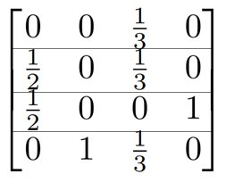
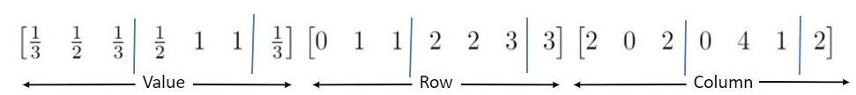
PageRank - Partitioning
Row Wise Partitioning Scheme:
Every row / Bunch of rows – 1 partition
Inefficient- No. Of non-zero elements vary in each
partition
Maximum Elements Partitioning Scheme:
Max. Elements which fit on the device – 1 partition
PESIT BSC

Slide 34
Breadth First Search
4
5
6
0
1
2
3
7
8
9
0 | 1 | 2 | 3 | 4 | 5 | 6 | 7 | 8 | 9 | 10 | 11 | 12 | 13 | 14 | 15 | 16 | 17 | 18 | 19 | 20 | 21
0 | 1 | 1 | 1 | 1 | 1 | 1 | 2 | 2 | 2 | 2 | 2 | 2 | 3 | 4 | 5 | 5 | 6 | 7 | 8 | 8 | 9
1 | 0 | 2 | 4 | 5 | 7 | 8 | 1 | 3 | 5 | 6 | 8 | 9 | 2 | 1 | 1 | 2 | 2 | 1 | 1 | 2 | 2
0 | 1 | 7 | 13 | 14 | 15 | 17 | 18 | 19 | 21 | 22
0 | 1 | 2 | 3 | 4 | 5 | 6 | 7 | 8 | 9
q
vis
0 | 0 | 0 | 0 | 0 | 0 | 0 | 0 | 0 | 0
PESIT BSC

Slide 35
Breadth First Search
4
5
REPEAT ‘V’ TIMES:
u = 0
for all neighbors ‘v’ of ‘u’ do
if(!vis[v]) do
vis[v] = 1
add ‘v’ to q
vis[u] = 1
6
0
1
2
3
7
8
9
0 | 1 | 2 | 3 | 4 | 5 | 6 | 7 | 8 | 9 | 10 | 11 | 12 | 13 | 14 | 15 | 16 | 17 | 18 | 19 | 20 | 21
1 | 0 | 2 | 4 | 5 | 7 | 8 | 1 | 3 | 5 | 6 | 8 | 9 | 2 | 1 | 1 | 2 | 2 | 1 | 1 | 2 | 2
0 | 1 | 7 | 13 | 14 | 15 | 17 | 18 | 19 | 21 | 22
0 | 1 | 2 | 3 | 4 | 5 | 6 | 7 | 8 | 9
q
vis
0
0 | 0 | 0 | 0 | 0 | 0 | 0 | 0 | 0 | 0
PESIT BSC

Slide 36
Breadth First Search
4
5
REPEAT ‘V’ TIMES:
u = 0
for all neighbors ‘v’ of ‘u’ do
if(!vis[v]) do
vis[v] = 1
add ‘v’ to q
vis[u] = 1
6
0
1
2
3
7
8
9
0 | 1 | 2 | 3 | 4 | 5 | 6 | 7 | 8 | 9 | 10 | 11 | 12 | 13 | 14 | 15 | 16 | 17 | 18 | 19 | 20 | 21
1 | 0 | 2 | 4 | 5 | 7 | 8 | 1 | 3 | 5 | 6 | 8 | 9 | 2 | 1 | 1 | 2 | 2 | 1 | 1 | 2 | 2
0 | 1 | 7 | 13 | 14 | 15 | 17 | 18 | 19 | 21 | 22
0 | 1 | 2 | 3 | 4 | 5 | 6 | 7 | 8 | 9
q
vis
0 | 1
1 | 1 | 0 | 0 | 0 | 0 | 0 | 0 | 0 | 0
PESIT BSC

Slide 37
Breadth First Search
4
5
REPEAT ‘V’ TIMES:
u = 1
for all neighbors ‘v’ of ‘u’ do
if(!vis[v]) do
vis[v] = 1
add ‘v’ to q
vis[u] = 1
6
0
1
2
3
7
8
9
0 | 1 | 2 | 3 | 4 | 5 | 6 | 7 | 8 | 9 | 10 | 11 | 12 | 13 | 14 | 15 | 16 | 17 | 18 | 19 | 20 | 21
1 | 0 | 2 | 4 | 5 | 7 | 8 | 1 | 3 | 5 | 6 | 8 | 9 | 2 | 1 | 1 | 2 | 2 | 1 | 1 | 2 | 2
0 | 1 | 7 | 13 | 14 | 15 | 17 | 18 | 19 | 21 | 22
0 | 1 | 2 | 3 | 4 | 5 | 6 | 7 | 8 | 9
q
vis
0 | 1
1 | 1 | 0 | 0 | 0 | 0 | 0 | 0 | 0 | 0
PESIT BSC

Slide 38
Breadth First Search
4
5
REPEAT ‘V’ TIMES:
u = 1
for all neighbors ‘v’ of ‘u’ do
if(!vis[v]) do
vis[v] = 1
add ‘v’ to q
vis[u] = 1
6
0
1
2
3
7
8
9
0 | 1 | 2 | 3 | 4 | 5 | 6 | 7 | 8 | 9 | 10 | 11 | 12 | 13 | 14 | 15 | 16 | 17 | 18 | 19 | 20 | 21
1 | 0 | 2 | 4 | 5 | 7 | 8 | 1 | 3 | 5 | 6 | 8 | 9 | 2 | 1 | 1 | 2 | 2 | 1 | 1 | 2 | 2
0 | 1 | 7 | 13 | 14 | 15 | 17 | 18 | 19 | 21 | 22
0 | 1 | 2 | 3 | 4 | 5 | 6 | 7 | 8 | 9
q
vis
0 | 1 | 2 | 4 | 5 | 7 | 8
1 | 1 | 1 | 0 | 1 | 1 | 0 | 1 | 1 | 0
PESIT BSC

Slide 39
Breadth First Search
4
5
REPEAT ‘V’ TIMES:
u = 2
for all neighbors ‘v’ of ‘u’ do
if(!vis[v]) do
vis[v] = 1
add ‘v’ to q
vis[u] = 1
6
0
1
2
3
7
8
9
0 | 1 | 2 | 3 | 4 | 5 | 6 | 7 | 8 | 9 | 10 | 11 | 12 | 13 | 14 | 15 | 16 | 17 | 18 | 19 | 20 | 21
1 | 0 | 2 | 4 | 5 | 7 | 8 | 1 | 3 | 5 | 6 | 8 | 9 | 2 | 1 | 1 | 2 | 2 | 1 | 1 | 2 | 2
0 | 1 | 7 | 13 | 14 | 15 | 17 | 18 | 19 | 21 | 22
0 | 1 | 2 | 3 | 4 | 5 | 6 | 7 | 8 | 9
q
vis
0 | 1 | 2 | 4 | 5 | 7 | 8
1 | 1 | 1 | 0 | 1 | 1 | 0 | 1 | 1 | 0
PESIT BSC

Slide 40
Breadth First Search
4
5
REPEAT ‘V’ TIMES:
u = 2
for all neighbors ‘v’ of ‘u’ do
if(!vis[v]) do
vis[v] = 1
add ‘v’ to q
vis[u] = 1
6
0
1
2
3
7
8
9
0 | 1 | 2 | 3 | 4 | 5 | 6 | 7 | 8 | 9 | 10 | 11 | 12 | 13 | 14 | 15 | 16 | 17 | 18 | 19 | 20 | 21
1 | 0 | 2 | 4 | 5 | 7 | 8 | 1 | 3 | 5 | 6 | 8 | 9 | 2 | 1 | 1 | 2 | 2 | 1 | 1 | 2 | 2
0 | 1 | 7 | 13 | 14 | 15 | 17 | 18 | 19 | 21 | 22
0 | 1 | 2 | 3 | 4 | 5 | 6 | 7 | 8 | 9
q
vis
0 | 1 | 2 | 4 | 5 | 7 | 8 | 3 | 6 | 9
1 | 1 | 1 | 1 | 1 | 1 | 1 | 1 | 1 | 1
PESIT BSC

Slide 41
Breadth First Search
4
5
REPEAT ‘V’ TIMES:
u = 4
for all neighbors ‘v’ of ‘u’ do
if(!vis[v]) do
vis[v] = 1
add ‘v’ to q
vis[u] = 1
6
0
1
2
3
7
8
9
0 | 1 | 2 | 3 | 4 | 5 | 6 | 7 | 8 | 9 | 10 | 11 | 12 | 13 | 14 | 15 | 16 | 17 | 18 | 19 | 20 | 21
1 | 0 | 2 | 4 | 5 | 7 | 8 | 1 | 3 | 5 | 6 | 8 | 9 | 2 | 1 | 1 | 2 | 2 | 1 | 1 | 2 | 2
0 | 1 | 7 | 13 | 14 | 15 | 17 | 18 | 19 | 21 | 22
0 | 1 | 2 | 3 | 4 | 5 | 6 | 7 | 8 | 9
q
vis
0 | 1 | 2 | 4 | 5 | 7 | 8 | 3 | 6 | 9
1 | 1 | 1 | 1 | 1 | 1 | 1 | 1 | 1 | 1
PESIT BSC

Slide 42
Breadth First Search
4
5
REPEAT ‘V’ TIMES:
u = 5
for all neighbors ‘v’ of ‘u’ do
if(!vis[v]) do
vis[v] = 1
add ‘v’ to q
vis[u] = 1
6
0
1
2
3
7
8
9
0 | 1 | 2 | 3 | 4 | 5 | 6 | 7 | 8 | 9 | 10 | 11 | 12 | 13 | 14 | 15 | 16 | 17 | 18 | 19 | 20 | 21
1 | 0 | 2 | 4 | 5 | 7 | 8 | 1 | 3 | 5 | 6 | 8 | 9 | 2 | 1 | 1 | 2 | 2 | 1 | 1 | 2 | 2
0 | 1 | 7 | 13 | 14 | 15 | 17 | 18 | 19 | 21 | 22
0 | 1 | 2 | 3 | 4 | 5 | 6 | 7 | 8 | 9
q
vis
0 | 1 | 2 | 4 | 5 | 7 | 8 | 3 | 6 | 9
1 | 1 | 1 | 1 | 1 | 1 | 1 | 1 | 1 | 1
PESIT BSC

Slide 43
Breadth First Search
4
5
REPEAT ‘V’ TIMES:
u = 9
for all neighbors ‘v’ of ‘u’ do
if(!vis[v]) do
vis[v] = 1
add ‘v’ to q
vis[u] = 1
6
0
1
2
3
7
8
9
0 | 1 | 2 | 3 | 4 | 5 | 6 | 7 | 8 | 9 | 10 | 11 | 12 | 13 | 14 | 15 | 16 | 17 | 18 | 19 | 20 | 21
1 | 0 | 2 | 4 | 5 | 7 | 8 | 1 | 3 | 5 | 6 | 8 | 9 | 2 | 1 | 1 | 2 | 2 | 1 | 1 | 2 | 2
0 | 1 | 7 | 13 | 14 | 15 | 17 | 18 | 19 | 21 | 22
0 | 1 | 2 | 3 | 4 | 5 | 6 | 7 | 8 | 9
q
vis
0 | 1 | 2 | 4 | 5 | 7 | 8 | 3 | 6 | 9
1 | 1 | 1 | 1 | 1 | 1 | 1 | 1 | 1 | 1
Final Traversal Order
PESIT BSC

Slide 44
Breadth First Search – PARTITIONING METHODOLOGY
4
5
GLOBAL
0 | 1 | 2 | 3 | 4 | 5 | 6 | 7 | 8 | 9
6
q
vis
0
0 | 0 | 0 | 0 | 0 | 0 | 0 | 0 | 0 | 0
0
1
2
3
7
8
9
0 | 1 | 2 | 3 | 4 | 5 | 6 | 7 | 8 | 9 | 10 | 11 | 12 | 13 | 14 | 15 | 16 | 17 | 18 | 19 | 20 | 21
1 | 0 | 2 | 4 | 5 | 7 | 8 | 1 | 3 | 5 | 6 | 8 | 9 | 2 | 1 | 1 | 2 | 2 | 1 | 1 | 2 | 2
0 | 1 | 7 | 13 | 14 | 15 | 17 | 18 | 19 | 21 | 22
1 | 6 | 6 | 1 | 1 | 2 | 1 | 1 | 2 | 1
LOCAL
REPEAT ‘V’ TIMES:
u = 0
partition(u, degree[u], queue, visited,neighbors)
vis[u] = 1
queue
visited
neighbors
0
1
PESIT BSC

Slide 45
Breadth First Search – PARTITIONING METHODOLOGY
4
5
GLOBAL
0 | 1 | 2 | 3 | 4 | 5 | 6 | 7 | 8 | 9
6
q
vis
0
0 | 0 | 0 | 0 | 0 | 0 | 0 | 0 | 0 | 0
0
1
2
3
7
8
9
0 | 1 | 2 | 3 | 4 | 5 | 6 | 7 | 8 | 9 | 10 | 11 | 12 | 13 | 14 | 15 | 16 | 17 | 18 | 19 | 20 | 21
1 | 0 | 2 | 4 | 5 | 7 | 8 | 1 | 3 | 5 | 6 | 8 | 9 | 2 | 1 | 1 | 2 | 2 | 1 | 1 | 2 | 2
0 | 1 | 7 | 13 | 14 | 15 | 17 | 18 | 19 | 21 | 22
1 | 6 | 6 | 1 | 1 | 2 | 1 | 1 | 2 | 1
LOCAL
REPEAT ‘V’ TIMES:
u = 0
partition(u, degree[u], queue, visited,neighbors)
vis[u] = 1
queue
visited
neighbors
1
0
1
PESIT BSC

Slide 46
Breadth First Search – PARTITIONING METHODOLOGY
4
5
GLOBAL
0 | 1 | 2 | 3 | 4 | 5 | 6 | 7 | 8 | 9
6
q
vis
0 | 1
1 | 1 | 0 | 0 | 0 | 0 | 0 | 0 | 0 | 0
0
1
2
3
7
8
9
0 | 1 | 2 | 3 | 4 | 5 | 6 | 7 | 8 | 9 | 10 | 11 | 12 | 13 | 14 | 15 | 16 | 17 | 18 | 19 | 20 | 21
1 | 0 | 2 | 4 | 5 | 7 | 8 | 1 | 3 | 5 | 6 | 8 | 9 | 2 | 1 | 1 | 2 | 2 | 1 | 1 | 2 | 2
0 | 1 | 7 | 13 | 14 | 15 | 17 | 18 | 19 | 21 | 22
1 | 6 | 6 | 1 | 1 | 2 | 1 | 1 | 2 | 1
LOCAL
REPEAT ‘V’ TIMES:
u = 0
partition(u, degree[u], queue, visited, neighbors)
vis[u] = 1
queue
visited
neighbors
1
1
1
PESIT BSC

Slide 47
Breadth First Search – PARTITIONING METHODOLOGY
4
5
GLOBAL
0 | 1 | 2 | 3 | 4 | 5 | 6 | 7 | 8 | 9
6
q
vis
0 | 1
1 | 1 | 0 | 0 | 0 | 0 | 0 | 0 | 0 | 0
0
1
2
3
7
8
9
0 | 1 | 2 | 3 | 4 | 5 | 6 | 7 | 8 | 9 | 10 | 11 | 12 | 13 | 14 | 15 | 16 | 17 | 18 | 19 | 20 | 21
1 | 0 | 2 | 4 | 5 | 7 | 8 | 1 | 3 | 5 | 6 | 8 | 9 | 2 | 1 | 1 | 2 | 2 | 1 | 1 | 2 | 2
0 | 1 | 7 | 13 | 14 | 15 | 17 | 18 | 19 | 21 | 22
1 | 6 | 6 | 1 | 1 | 2 | 1 | 1 | 2 | 1
LOCAL
REPEAT ‘V’ TIMES:
u = 1
partition(u, degree[u], queue, visited,neighbors)
vis[u] = 1
queue
visited
neighbors
1 | 0 | 0 | 0 | 0 | 0
0 | 2 | 4 | 5 | 7 | 8
PESIT BSC

Slide 48
Breadth First Search – PARTITIONING METHODOLOGY
4
5
GLOBAL
0 | 1 | 2 | 3 | 4 | 5 | 6 | 7 | 8 | 9
6
q
vis
0 | 1
1 | 1 | 0 | 0 | 0 | 0 | 0 | 0 | 0 | 0
0
1
2
3
7
8
9
0 | 1 | 2 | 3 | 4 | 5 | 6 | 7 | 8 | 9 | 10 | 11 | 12 | 13 | 14 | 15 | 16 | 17 | 18 | 19 | 20 | 21
1 | 0 | 2 | 4 | 5 | 7 | 8 | 1 | 3 | 5 | 6 | 8 | 9 | 2 | 1 | 1 | 2 | 2 | 1 | 1 | 2 | 2
0 | 1 | 7 | 13 | 14 | 15 | 17 | 18 | 19 | 21 | 22
1 | 6 | 6 | 1 | 1 | 2 | 1 | 1 | 2 | 1
LOCAL
REPEAT ‘V’ TIMES:
u = 1
partition(u, degree[u], queue, visited,neighbors)
vis[u] = 1
queue
visited
neighbors
2 | 4 | 5 | 7 | 8
1 | 1 | 1 | 1 | 1 | 1
0 | 2 | 4 | 5 | 7 | 8
PESIT BSC

Slide 49
Breadth First Search – PARTITIONING METHODOLOGY
4
5
GLOBAL
0 | 1 | 2 | 3 | 4 | 5 | 6 | 7 | 8 | 9
6
q
vis
0 | 1 | 2 | 4 | 5 | 7 | 8
1 | 1 | 1 | 0 | 1 | 1 | 0 | 1 | 1 | 0
0
1
2
3
7
8
9
0 | 1 | 2 | 3 | 4 | 5 | 6 | 7 | 8 | 9 | 10 | 11 | 12 | 13 | 14 | 15 | 16 | 17 | 18 | 19 | 20 | 21
1 | 0 | 2 | 4 | 5 | 7 | 8 | 1 | 3 | 5 | 6 | 8 | 9 | 2 | 1 | 1 | 2 | 2 | 1 | 1 | 2 | 2
0 | 1 | 7 | 13 | 14 | 15 | 17 | 18 | 19 | 21 | 22
1 | 6 | 6 | 1 | 1 | 2 | 1 | 1 | 2 | 1
LOCAL
REPEAT ‘V’ TIMES:
u = 1
partition(u, degree[u], queue, visited,neighbors)
vis[u] = 1
queue
visited
neighbors
2 | 4 | 5 | 7 | 8
1 | 1 | 1 | 1 | 1 | 1
0 | 2 | 4 | 5 | 7 | 8
PESIT BSC

Slide 50
Breadth First Search – PARTITIONING METHODOLOGY
4
5
GLOBAL
0 | 1 | 2 | 3 | 4 | 5 | 6 | 7 | 8 | 9
6
q
vis
0 | 1 | 2 | 4 | 5 | 7 | 8
1 | 1 | 1 | 0 | 1 | 1 | 0 | 1 | 1 | 0
0
1
2
3
7
8
9
0 | 1 | 2 | 3 | 4 | 5 | 6 | 7 | 8 | 9 | 10 | 11 | 12 | 13 | 14 | 15 | 16 | 17 | 18 | 19 | 20 | 21
1 | 0 | 2 | 4 | 5 | 7 | 8 | 1 | 3 | 5 | 6 | 8 | 9 | 2 | 1 | 1 | 2 | 2 | 1 | 1 | 2 | 2
0 | 1 | 7 | 13 | 14 | 15 | 17 | 18 | 19 | 21 | 22
1 | 6 | 6 | 1 | 1 | 2 | 1 | 1 | 2 | 1
LOCAL
REPEAT ‘V’ TIMES:
u = 2
partition(u, degree[u], queue, visited,neighbors)
vis[u] = 1
queue
visited
neighbors
1 | 0 | 1 | 0 | 1 | 0
1 | 3 | 5 | 6 | 8 | 9
PESIT BSC

Slide 51
Breadth First Search – PARTITIONING METHODOLOGY
4
5
GLOBAL
0 | 1 | 2 | 3 | 4 | 5 | 6 | 7 | 8 | 9
6
q
vis
0 | 1 | 2 | 4 | 5 | 7 | 8
1 | 1 | 1 | 0 | 1 | 1 | 0 | 1 | 1 | 0
0
1
2
3
7
8
9
0 | 1 | 2 | 3 | 4 | 5 | 6 | 7 | 8 | 9 | 10 | 11 | 12 | 13 | 14 | 15 | 16 | 17 | 18 | 19 | 20 | 21
1 | 0 | 2 | 4 | 5 | 7 | 8 | 1 | 3 | 5 | 6 | 8 | 9 | 2 | 1 | 1 | 2 | 2 | 1 | 1 | 2 | 2
0 | 1 | 7 | 13 | 14 | 15 | 17 | 18 | 19 | 21 | 22
1 | 6 | 6 | 1 | 1 | 2 | 1 | 1 | 2 | 1
LOCAL
REPEAT ‘V’ TIMES:
u = 2
partition(u, degree[u], queue, visited,neighbors)
vis[u] = 1
queue
visited
neighbors
3 | 6 | 9
1 | 1 | 1 | 1 | 1 | 1
1 | 3 | 5 | 6 | 8 | 9
PESIT BSC

Slide 52
Breadth First Search – PARTITIONING METHODOLOGY
4
5
GLOBAL
0 | 1 | 2 | 3 | 4 | 5 | 6 | 7 | 8 | 9
6
q
vis
0 | 1 | 2 | 4 | 5 | 7 | 8 | 3 | 6 | 9
1 | 1 | 1 | 1 | 1 | 1 | 1 | 1 | 1 | 1
0
1
2
3
7
8
9
0 | 1 | 2 | 3 | 4 | 5 | 6 | 7 | 8 | 9 | 10 | 11 | 12 | 13 | 14 | 15 | 16 | 17 | 18 | 19 | 20 | 21
1 | 0 | 2 | 4 | 5 | 7 | 8 | 1 | 3 | 5 | 6 | 8 | 9 | 2 | 1 | 1 | 2 | 2 | 1 | 1 | 2 | 2
0 | 1 | 7 | 13 | 14 | 15 | 17 | 18 | 19 | 21 | 22
1 | 6 | 6 | 1 | 1 | 2 | 1 | 1 | 2 | 1
LOCAL
REPEAT ‘V’ TIMES:
u = 2
partition(u, degree[u], queue, visited,neighbors)
vis[u] = 1
queue
visited
neighbors
3 | 6 | 9
1 | 1 | 1 | 1 | 1 | 1
1 | 3 | 5 | 6 | 8 | 9
PESIT BSC

Slide 53
Breadth First Search – PARTITIONING METHODOLOGY
4
5
GLOBAL
0 | 1 | 2 | 3 | 4 | 5 | 6 | 7 | 8 | 9
6
q
vis
0 | 1 | 2 | 4 | 5 | 7 | 8 | 3 | 6 | 9
1 | 1 | 1 | 1 | 1 | 1 | 1 | 1 | 1 | 1
0
1
2
3
7
8
9
0 | 1 | 2 | 3 | 4 | 5 | 6 | 7 | 8 | 9 | 10 | 11 | 12 | 13 | 14 | 15 | 16 | 17 | 18 | 19 | 20 | 21
1 | 0 | 2 | 4 | 5 | 7 | 8 | 1 | 3 | 5 | 6 | 8 | 9 | 2 | 1 | 1 | 2 | 2 | 1 | 1 | 2 | 2
0 | 1 | 7 | 13 | 14 | 15 | 17 | 18 | 19 | 21 | 22
1 | 6 | 6 | 1 | 1 | 2 | 1 | 1 | 2 | 1
LOCAL
REPEAT ‘V’ TIMES:
u = 9
partition(u, degree[u], queue, visited,neighbors)
vis[u] = 1
queue
visited
neighbors
1
2
PESIT BSC

Slide 54
DEPTH FIRST SEARCH (DFS)
4
5
6
0
1
2
3
7
8
9
0 | 1 | 2 | 3 | 4 | 5 | 6 | 7 | 8 | 9 | 10 | 11 | 12 | 13 | 14 | 15 | 16 | 17 | 18 | 19 | 20 | 21
U
0 | 1 | 1 | 1 | 1 | 1 | 1 | 2 | 2 | 2 | 2 | 2 | 2 | 3 | 4 | 5 | 5 | 6 | 7 | 8 | 8 | 9
V
1 | 0 | 2 | 4 | 5 | 7 | 8 | 1 | 3 | 5 | 6 | 8 | 9 | 2 | 1 | 1 | 2 | 2 | 1 | 1 | 2 | 2
ST
0 | 0 | 0 | 0 | 0 | 0 | 0 | 0 | 0 | 0
0 | 1 | 2 | 3 | 4 | 5 | 6 | 7 | 8 | 9
vis
d
0 | 0 | 0 | 0 | 0 | 0 | 0 | 0 | 0 | 0
0 | 0 | 0 | 0 | 0 | 0 | 0 | 0 | 0 | 0
PESIT BSC

Slide 55
DEPTH FIRST SEARCH (DFS)
4
5
6
REPEAT ‘V’ TIMES:
s = 0
add s to ST
remove s from ST
if(vis[s]==0) do
vis[s] = 1;
add s to d
for all neighbors ‘v’ of ‘s’ do
if((u[i] == s) && (vis[v[i]] == 0))do
ST[++top] = v[i]
0
1
2
3
7
8
9
0 | 1 | 2 | 3 | 4 | 5 | 6 | 7 | 8 | 9 | 10 | 11 | 12 | 13 | 14 | 15 | 16 | 17 | 18 | 19 | 20 | 21
U
0 | 1 | 1 | 1 | 1 | 1 | 1 | 2 | 2 | 2 | 2 | 2 | 2 | 3 | 4 | 5 | 5 | 6 | 7 | 8 | 8 | 9
V
1 | 0 | 2 | 4 | 5 | 7 | 8 | 1 | 3 | 5 | 6 | 8 | 9 | 2 | 1 | 1 | 2 | 2 | 1 | 1 | 2 | 2
ST
0
0 | 1 | 2 | 3 | 4 | 5 | 6 | 7 | 8 | 9
vis
d
1 | 0 | 0 | 0 | 0 | 0 | 0 | 0 | 0 | 0
0
PESIT BSC

Slide 56
DEPTH FIRST SEARCH (DFS)
4
5
6
REPEAT ‘V’ TIMES:
s = 0
add s to ST
remove s from ST
if(vis[s]==0) do
vis[s] = 1;
add s to d
for all neighbors ‘v’ of ‘s’ do
if((u[i] == s) && (vis[v[i]] == 0))do
ST[++top] = v[i]
0
1
2
3
7
8
9
0 | 1 | 2 | 3 | 4 | 5 | 6 | 7 | 8 | 9 | 10 | 11 | 12 | 13 | 14 | 15 | 16 | 17 | 18 | 19 | 20 | 21
U
0 | 1 | 1 | 1 | 1 | 1 | 1 | 2 | 2 | 2 | 2 | 2 | 2 | 3 | 4 | 5 | 5 | 6 | 7 | 8 | 8 | 9
V
1 | 0 | 2 | 4 | 5 | 7 | 8 | 1 | 3 | 5 | 6 | 8 | 9 | 2 | 1 | 1 | 2 | 2 | 1 | 1 | 2 | 2
ST
0 | 1
0 | 1 | 2 | 3 | 4 | 5 | 6 | 7 | 8 | 9
vis
d
1 | 1 | 0 | 0 | 0 | 0 | 0 | 0 | 0 | 0
0 | 1
PESIT BSC

Slide 57
DEPTH FIRST SEARCH (DFS)
4
4
5
REPEAT ‘V’ TIMES:
s = 0
add s to ST
remove s from ST
if(vis[s]==0) do
vis[s] = 1;
add s to d
for all neighbors ‘v’ of ‘s’ do
if((u[i] == s) && (vis[v[i]] == 0))do
ST[++top] = v[i]
5
6
6
3
1
3
1
2
0
2
0
9
8
9
7
8
7
0 | 1 | 2 | 3 | 4 | 5 | 6 | 7 | 8 | 9 | 10 | 11 | 12 | 13 | 14 | 15 | 16 | 17 | 18 | 19 | 20 | 21
0 | 1 | 2 | 3 | 4 | 5 | 6 | 7 | 8 | 9 | 10 | 11 | 12 | 13 | 14 | 15 | 16 | 17 | 18 | 19 | 20 | 21
U
U
0 | 1 | 1 | 1 | 1 | 1 | 1 | 2 | 2 | 2 | 2 | 2 | 2 | 3 | 4 | 5 | 5 | 6 | 7 | 8 | 8 | 9
0 | 1 | 1 | 1 | 1 | 1 | 1 | 2 | 2 | 2 | 2 | 2 | 2 | 3 | 4 | 5 | 5 | 6 | 7 | 8 | 8 | 9
V
V
1 | 0 | 2 | 4 | 5 | 7 | 8 | 1 | 3 | 5 | 6 | 8 | 9 | 2 | 1 | 1 | 2 | 2 | 1 | 1 | 2 | 2
1 | 0 | 2 | 4 | 5 | 7 | 8 | 1 | 3 | 5 | 6 | 8 | 9 | 2 | 1 | 1 | 2 | 2 | 1 | 1 | 2 | 2
ST
ST
0 | 1 | 2
0 | 1 | 2 | 3 | 4 | 5 | 6 | 7 | 8 | 9
0 | 1 | 2 | 3 | 4 | 5 | 6 | 7 | 8 | 9
1 | 1 | 0 | 1 | 0 | 0 | 0 | 0 | 0 | 0
vis
d
1 | 1 | 1 | 0 | 0 | 0 | 0 | 0 | 0 | 0
vis
d
0 | 1 | 2
0 | 1 | 2
PESIT BSC

Slide 58
DEPTH FIRST SEARCH (DFS)
4
5
6
REPEAT ‘V’ TIMES:
s = 0
add s to ST
remove s from ST
if(vis[s]==0) do
vis[s] = 1;
add s to d
for all neighbors ‘v’ of ‘s’ do
if((u[i] == s) && (vis[v[i]] == 0))do
ST[++top] = v[i]
0
1
2
3
7
8
9
0 | 1 | 2 | 3 | 4 | 5 | 6 | 7 | 8 | 9 | 10 | 11 | 12 | 13 | 14 | 15 | 16 | 17 | 18 | 19 | 20 | 21
U
0 | 1 | 1 | 1 | 1 | 1 | 1 | 2 | 2 | 2 | 2 | 2 | 2 | 3 | 4 | 5 | 5 | 6 | 7 | 8 | 8 | 9
V
1 | 0 | 2 | 4 | 5 | 7 | 8 | 1 | 3 | 5 | 6 | 8 | 9 | 2 | 1 | 1 | 2 | 2 | 1 | 1 | 2 | 2
ST
0 | 1 | 2 | 3
0 | 1 | 2 | 3 | 4 | 5 | 6 | 7 | 8 | 9
vis
d
1 | 1 | 1 | 1 | 0 | 0 | 0 | 0 | 0 | 0
0 | 1 | 2 | 3
PESIT BSC

Slide 59
DEPTH FIRST SEARCH (DFS)
4
4
5
5
6
6
3
1
3
1
2
0
2
0
9
8
9
7
8
0 | 1 | 2 | 3
7
0 | 1 | 2 | 5
0 | 1 | 2 | 6
0 | 1 | 2 | 8
0 | 1 | 2 | 9
0 | 1 | 4
0 | 1 | 7
0 | 1
0
PESIT BSC

Slide 60
DEPTH FIRST SEARCH (DFS)
4
4
5
5
6
6
3
1
3
1
2
0
2
0
9
8
9
7
8
7
0 | 1 | 2 | 3 | 4 | 5 | 6 | 7 | 8 | 9
d
vis
ST
0 | 1 | 2 | 3 | 5 | 6 | 8 | 9 | 4 | 7
1 | 1 | 1 | 1 | 1 | 1 | 1 | 1 | 1 | 1
DFS TRAVERSAL
PESIT BSC

Slide 61
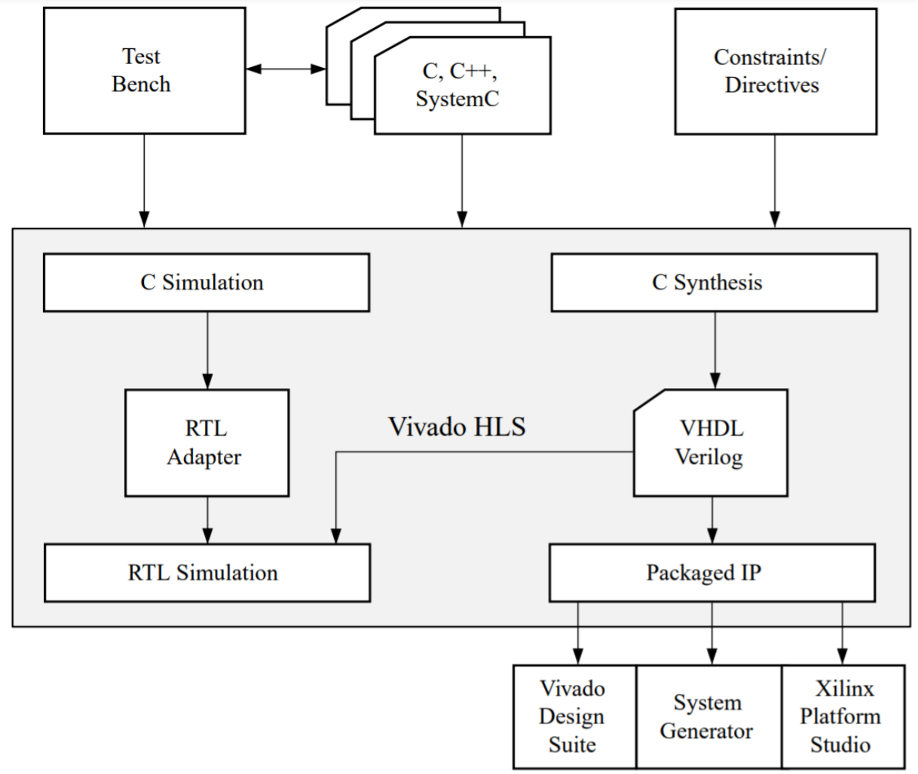
Software: Vivado HLS and Vivado Design Suite
Vivado HLS tool synthesizes a C function into an IP block that can be which can be exported.
Steps:
Compile, Simulate and Debug​
Synthesize into an RTL implementation​
Generate Reports and Analyze​
Verify the RTL Implementation​
Package into IP format
Vivado Design Suite:
Steps:
Import the IP and create Block design
Create HDL Wrapper
Run Synthesis and Implementation
Generate Bitstream and export it.
Write the host code and validate
your design on the board
Overview of Vivado HLS
Source : Xilinx Documentation - Vivado Design Suite User Guide High-Level Synthesis​
PESIT BSC

Slide 62
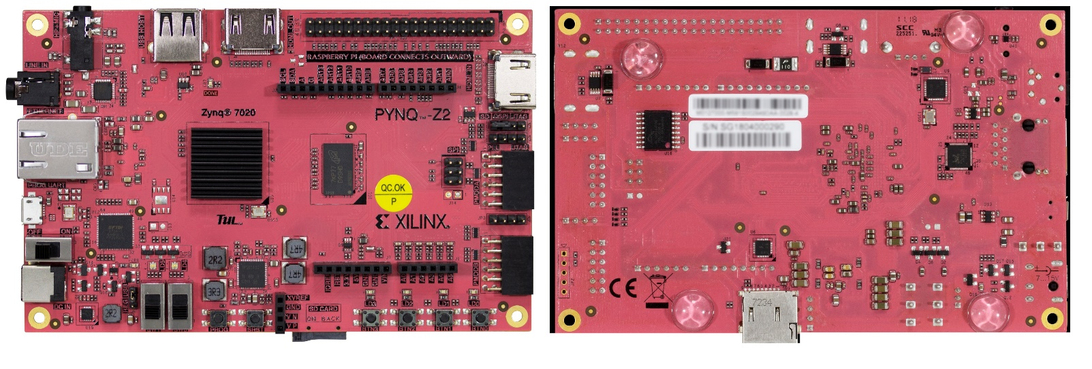
Hardware: PYNQ Z2 Board
Source: www.tul.com.tw/pynqz2.html
PYNQ is an open-source project from Xilinx.
By Employing Python language and libraries, designers can exploit the advantages of programmable logic and microprocessors.
PYNQ can be used with Zynq, Zynq Ultra Scale+ accelerator boards.
Features of PYNQ-Z2:
650MHz ARM Cortex-A9 dual-core processor
13,300 logic slices, each with four 6-input LUTs and 8 flipflops
630 KB block RAM
220 DSP slices
One On-chip Xilinx analog-to-digital converter (XADC)
PESIT BSC

Slide 63
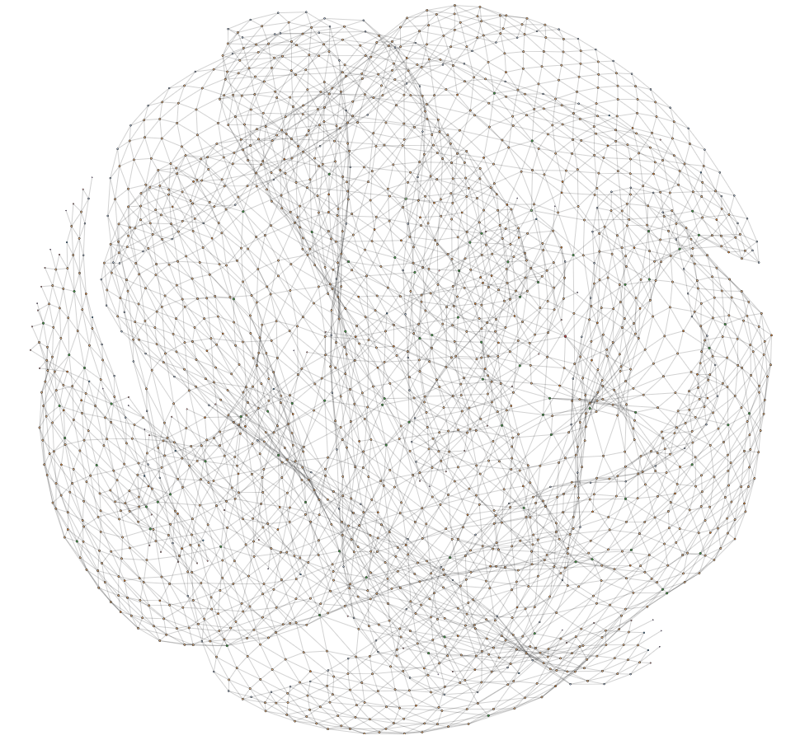
RESULTS
ALGORITHM | LATENCY (in cycles) | CLOCK (ns) | EXECUTION TIME (ms) | GAP BENCHMARK TIMINGS (ms) | Speed Up
BFS | 311520 | 6.319 | 1.968 | 9.808 | 5x
SSSP | 457840 | 7.282 | 3.33 | 67.215 | 20x
PageRank | 2648400 | 8.644 | 22.89 | 1.256 | 0.06x
DFS | 335354529 | 8.373 | 2808 | - | -
ALGORITHM | Energy consumed on FPGA (J) | Energy consumed on CPU (J)
BFS | 0.003338 | 0.0193
PageRank | 0.03847 | 0.002267
SSSP | 0.00565 | 0.132
Graph Size:
V=4720
E=27444
System Specifications of Benchmark execution:
CPU: AMD A9-9420 @3GHz| OS: KDE neon| RAM: 8GB
PESIT BSC

Slide 64
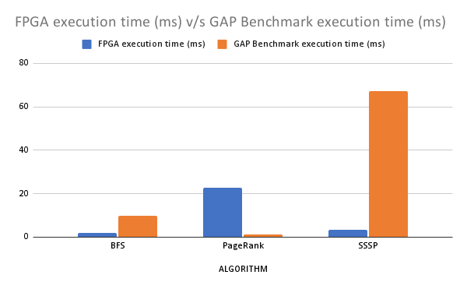
RESULTS
GitHub Repository: https://github.com/annette-antony/fpga-graph-accelerator-hls
PESIT BSC

Slide 65
WORK DIVISION
The four of us divided the graph algorithms among ourselves such that:
Avani S was assigned Single Source Shortest Path Algorithm.
Annette Antony was assigned the PageRank Algorithm.
Bhimala Subbarayudu was assigned the Breadth-First-Search Algorithm.
Jeevan R was assigned the Depth-First-Search Algorithm.
Each of us were responsible for our individual algorithms in terms of:
Improving performance.
Trying different partitioning techniques and
Validating the code.
PESIT BSC

Slide 66
REFERENCES
Graph Processing on FPGAs: Taxonomy, Survey, Challenges by Maciej Besta, Dimitri Standojevic et al.
Evaluation of Graph Analytics Frameworks Using the GAP Benchmark Suite by Ariful Azad, Mohsen Mahmoudi Aznavehy, Scott Beamer et al.
A Study of Partitioning Policies for Graph Analytics on Largescale Distributed Platforms by Gurbinder Gill, Roshan Dathathri, Loc Hoang and Keshav Pingali.
Vitis High-Level Synthesis User Guide by Xilinx
Vivado Design Suite User Guide by Xilinx
Parallel Programming for FPGAs by Ryan Kastner, Janarbek Matai, and Stephen Neuendorffer.
https://github.com/purtroppo/PageRank
http://networkrepository.com/3elt.php#panel-body

Slide 67
Thank you!
Source: Google Images
PESIT BSC
Notes:
That’s our work. Thanks for listening to our presentation. If you are interested in our work, feel free to ask any questions.

